Slide 1
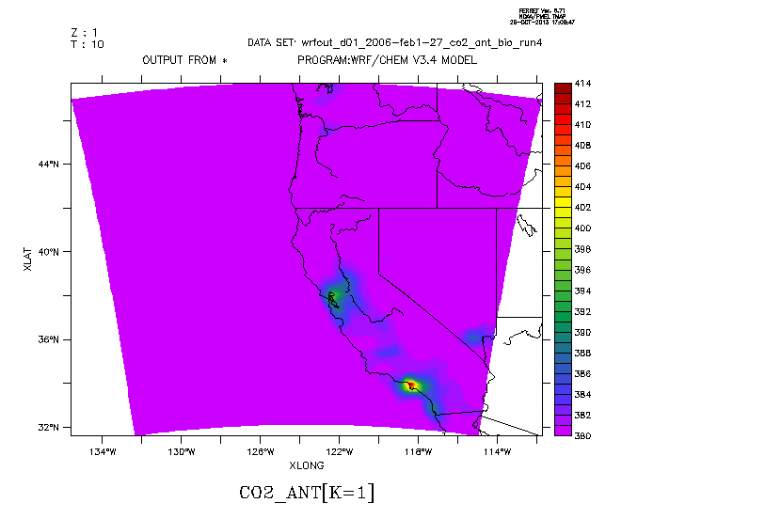
WRF Simulation Results: Animations (Ferret)

Slide 2
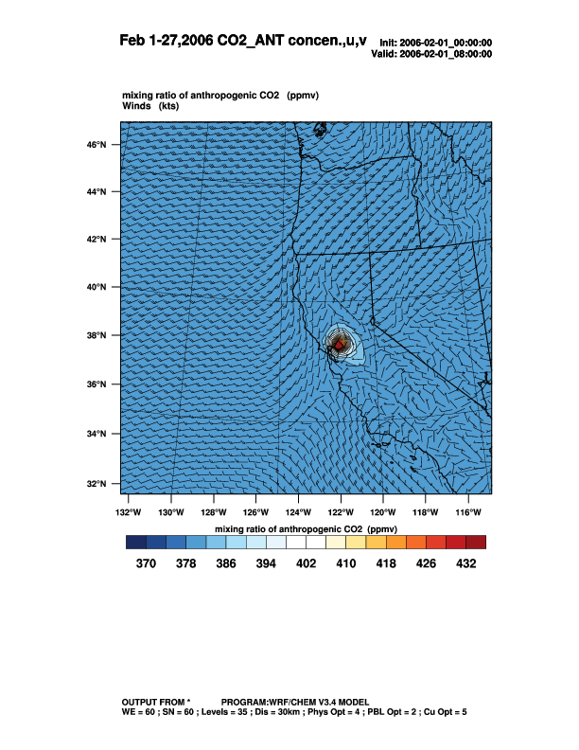
WRF Simulation Results: Animations (NCL)

